Slide 1
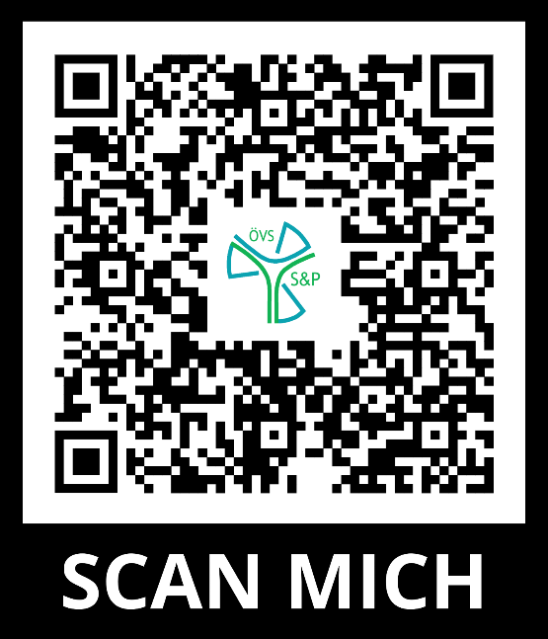
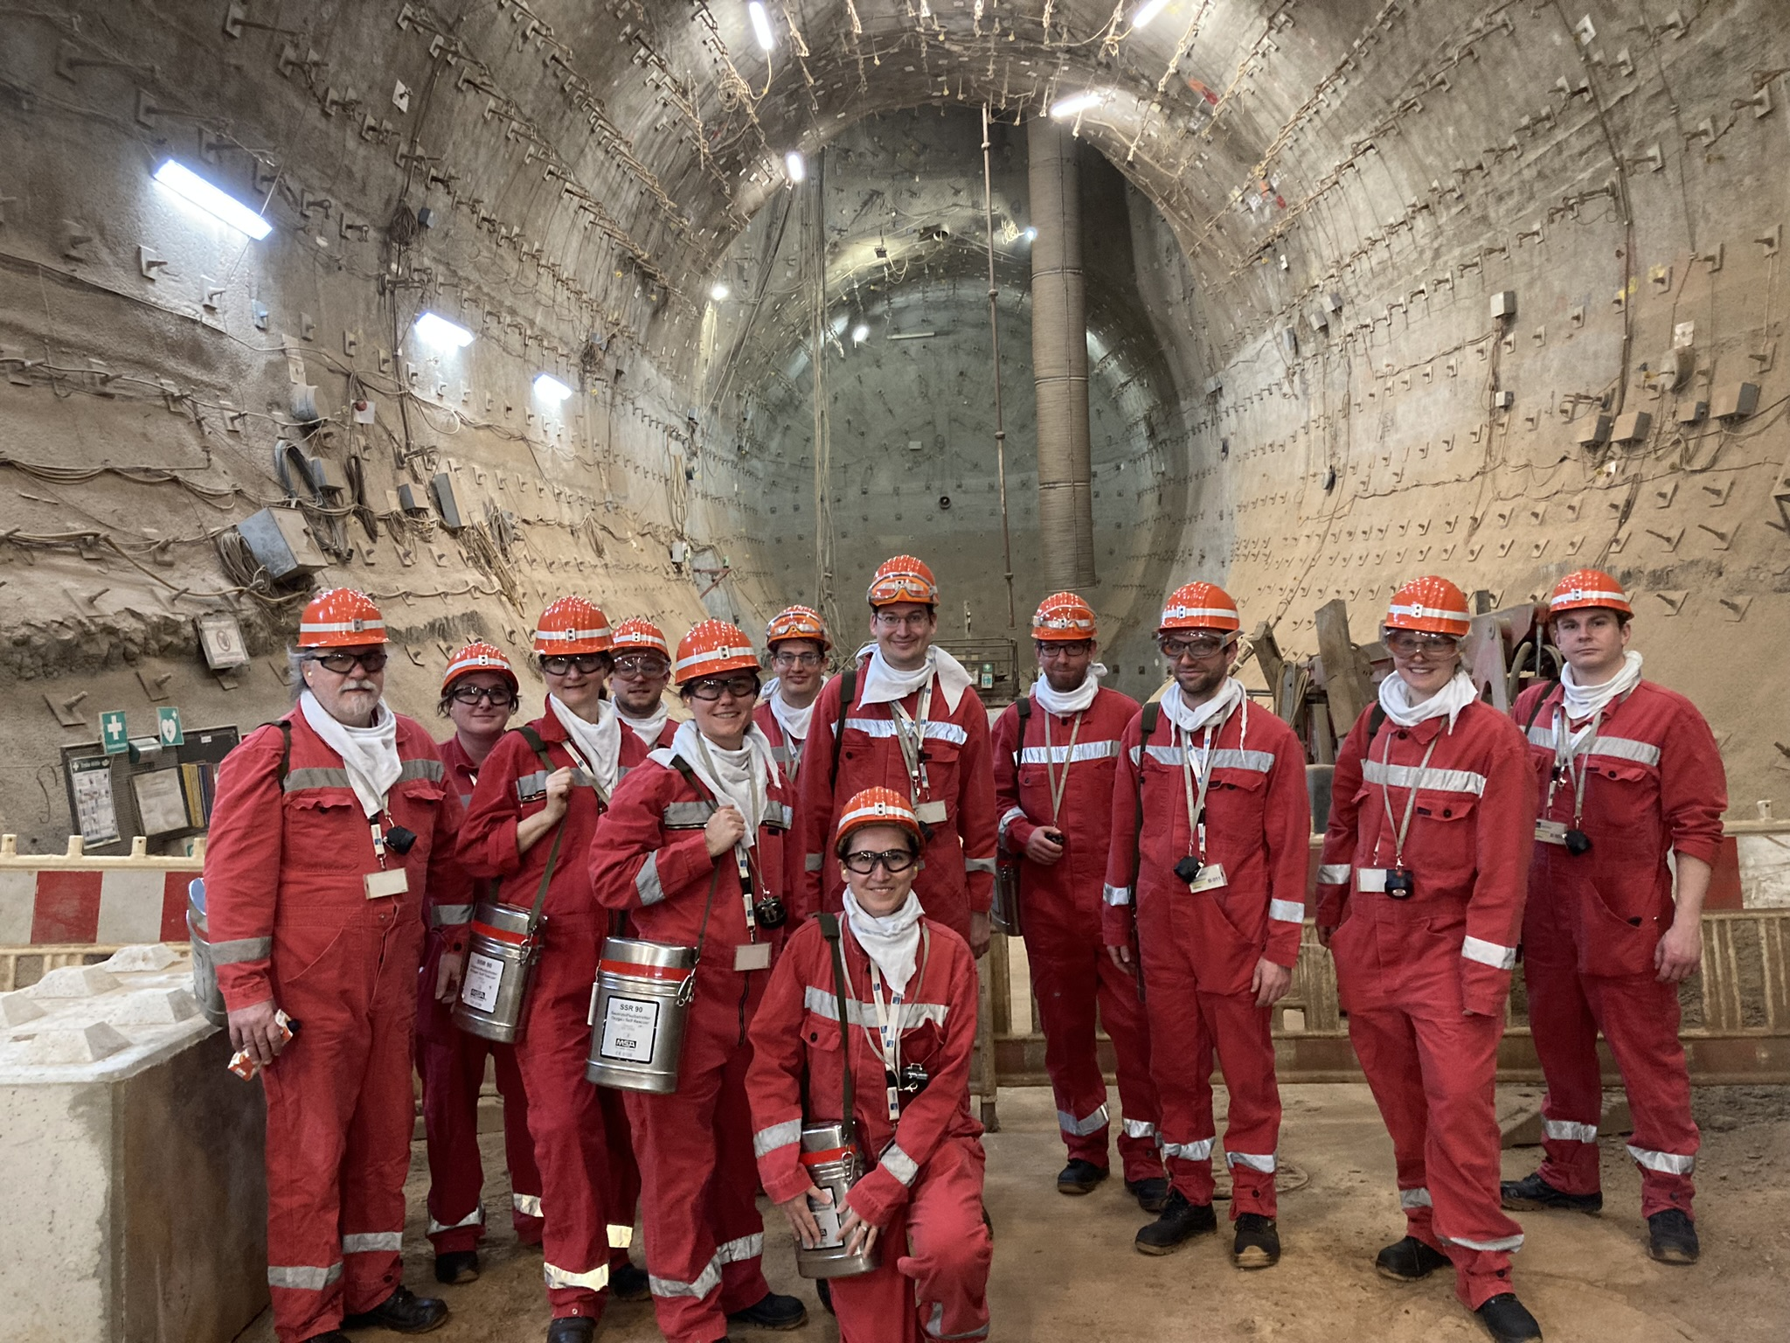
Join us!
XXX
AUSTRIAN ASSOCIATION FOR RADIATION PROTECTION
Member of the International Radiation Protection Association

Slide 2
Austrian Association for Radiation Protection
Facts
285 members
69 Young Scientists & Professionals (YS&P)
YS&P criteria
ÖVS membership < 5 years
Max. 10 years in radiation protection
Age ≤ 35
Prices and scholarships
Žakovsky-Price
Research and travel grants
Konrad-Mück-Scholarships

Slide 3
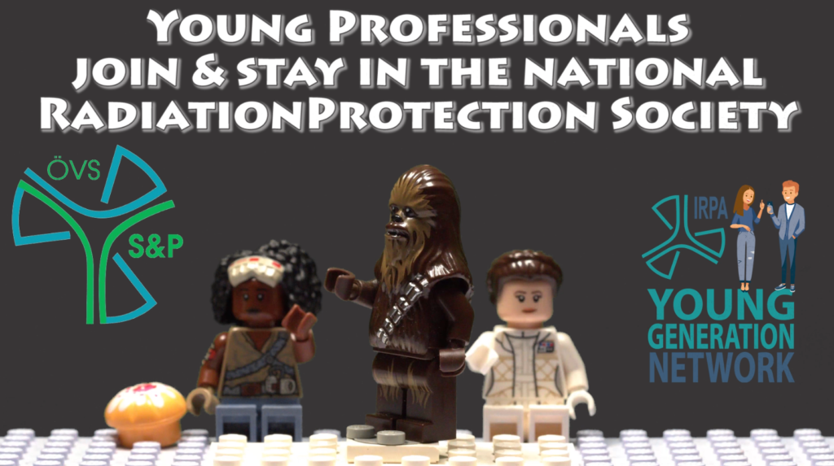
Young Scientists & Professionals

Slide 4
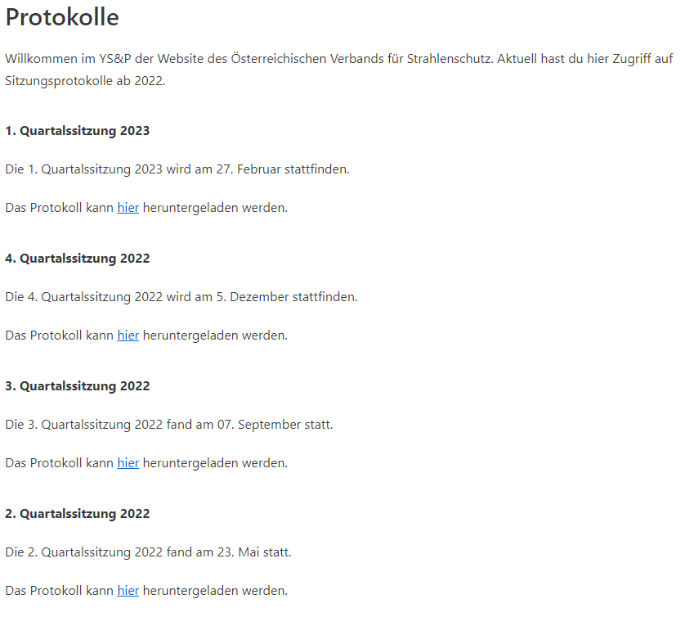
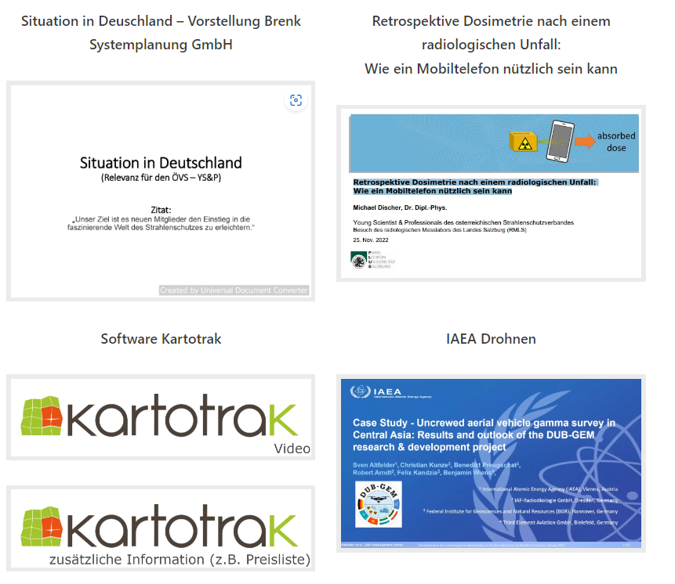
Online Meetings and Webinars
4 times per year

Slide 5
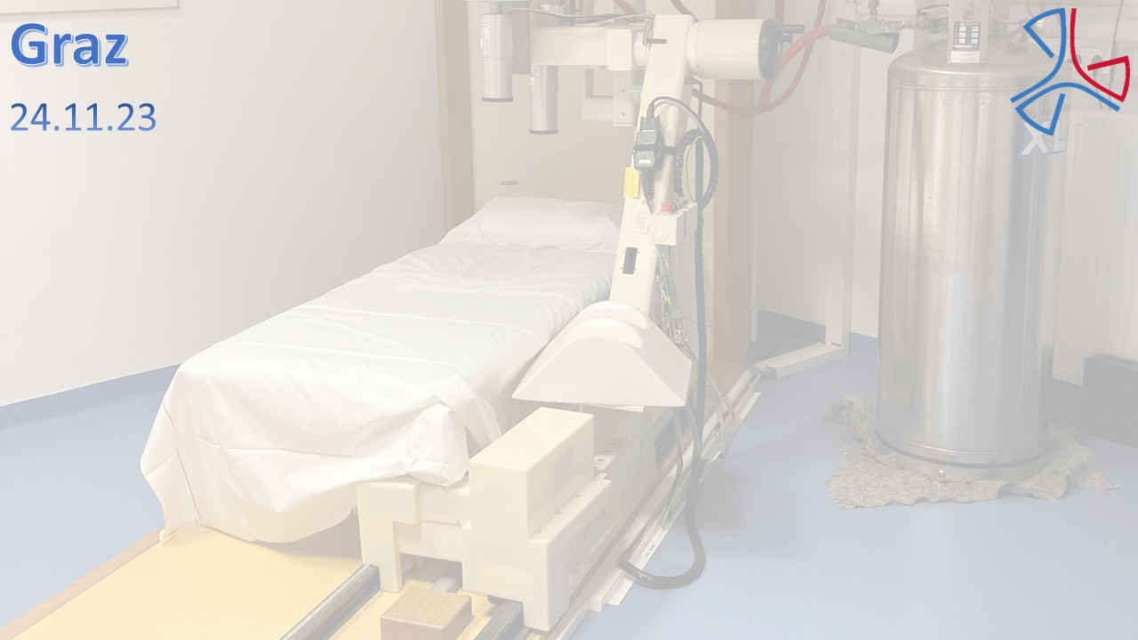
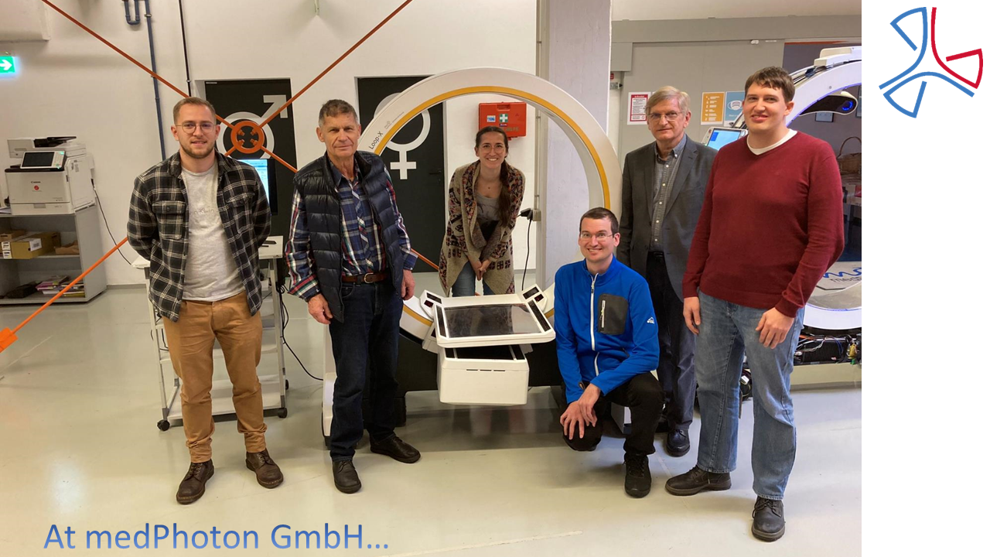
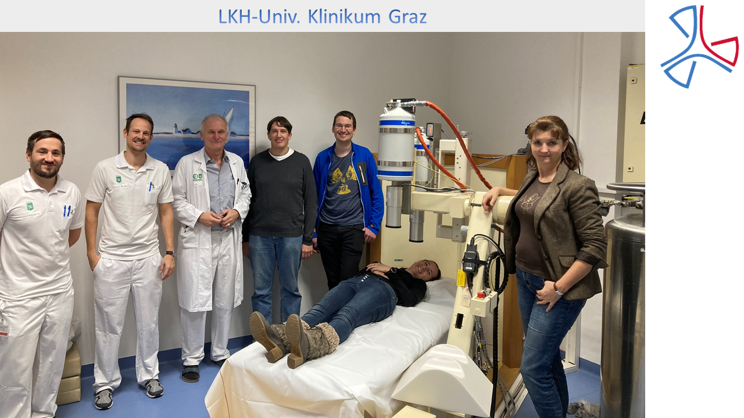
Personal Meetings
At least once per year

Slide 6
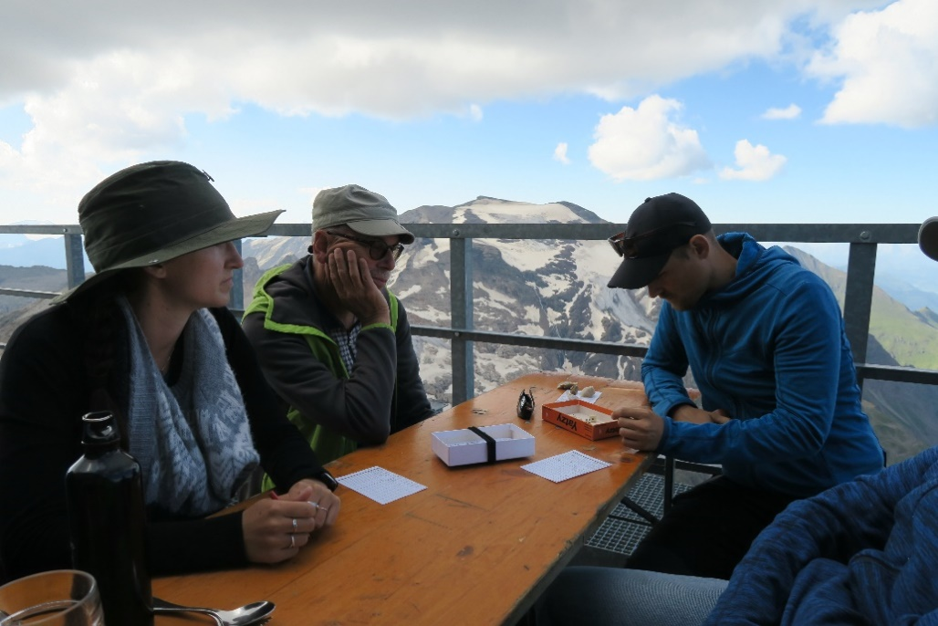
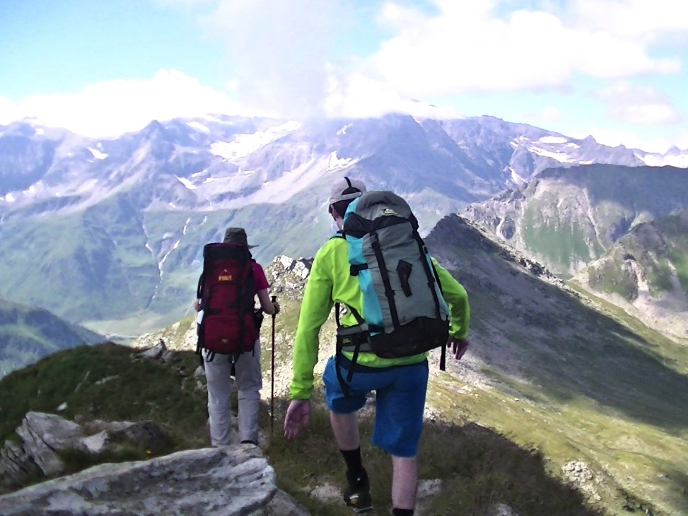
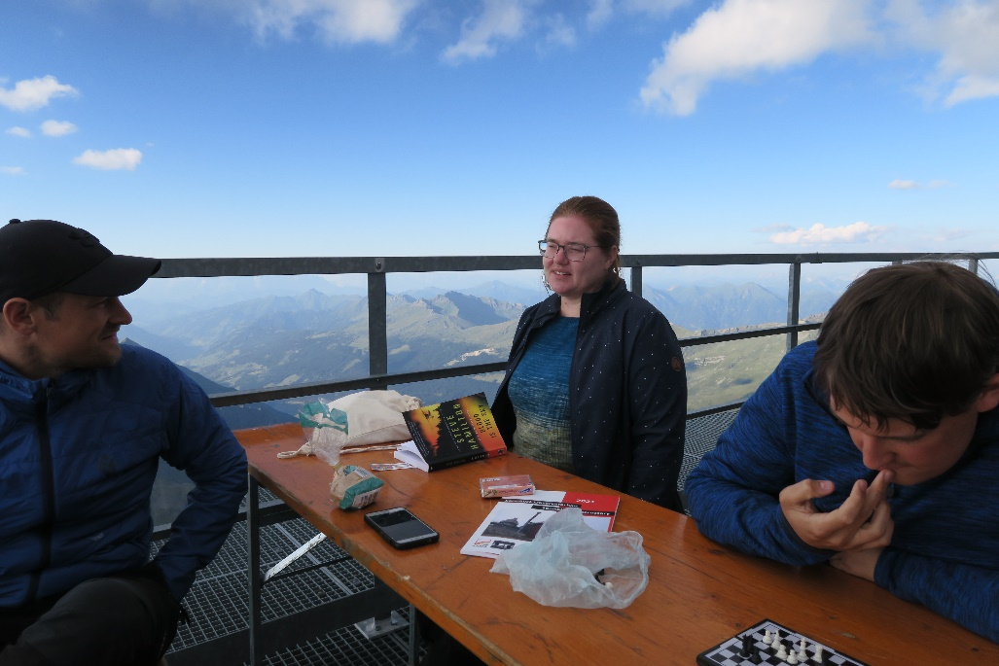
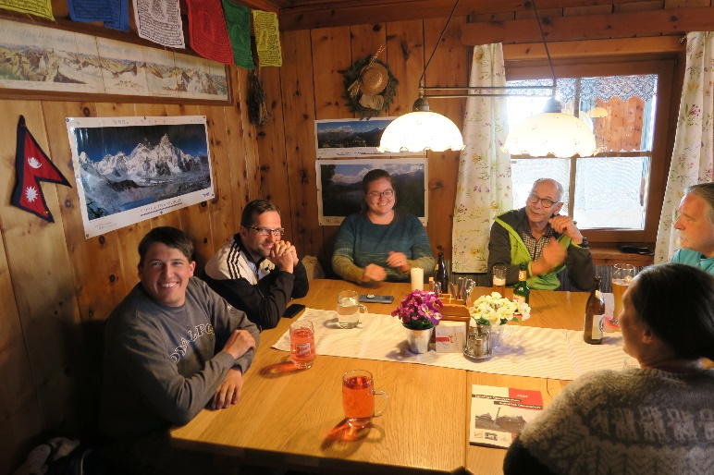
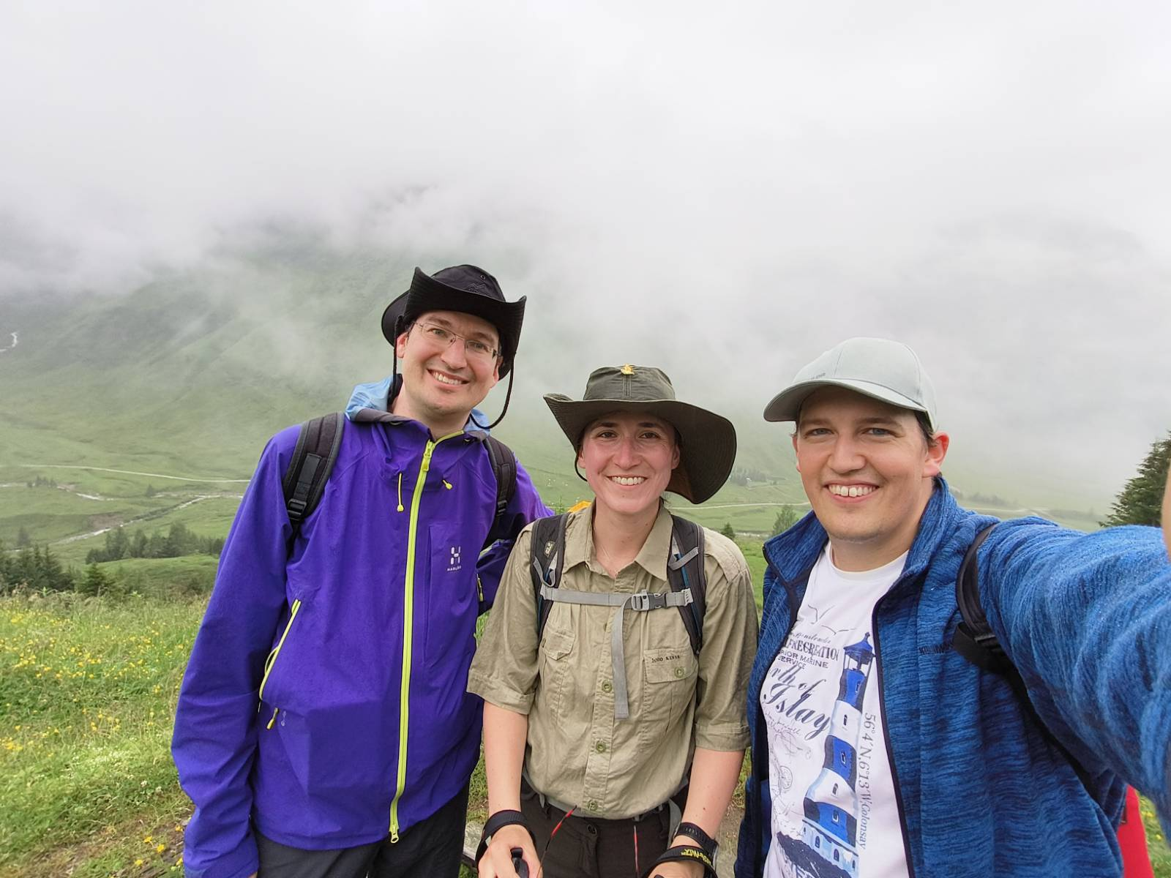
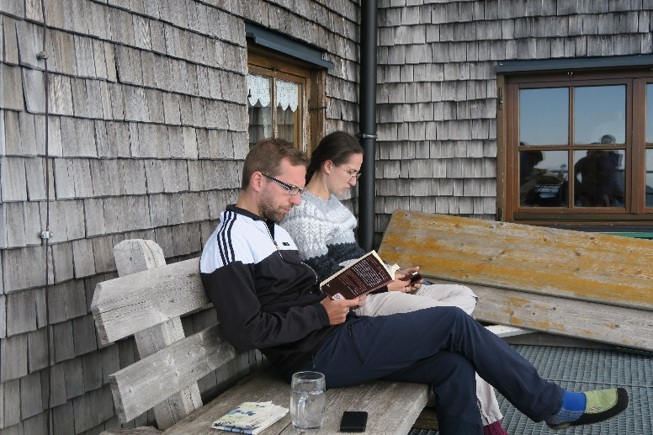
Downtime
= Bonding

Slide 7
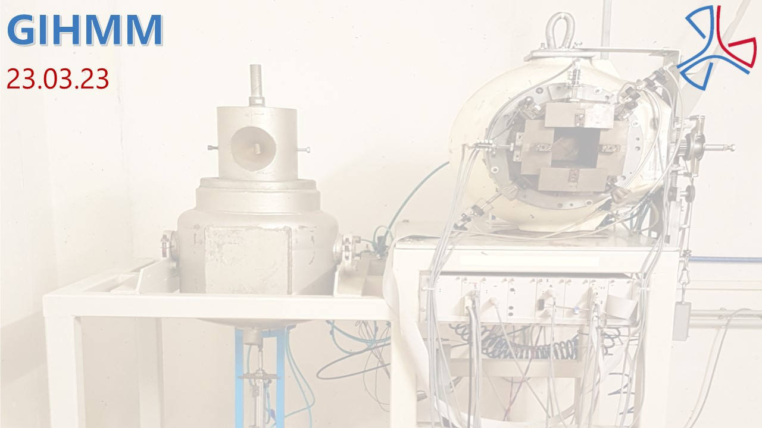
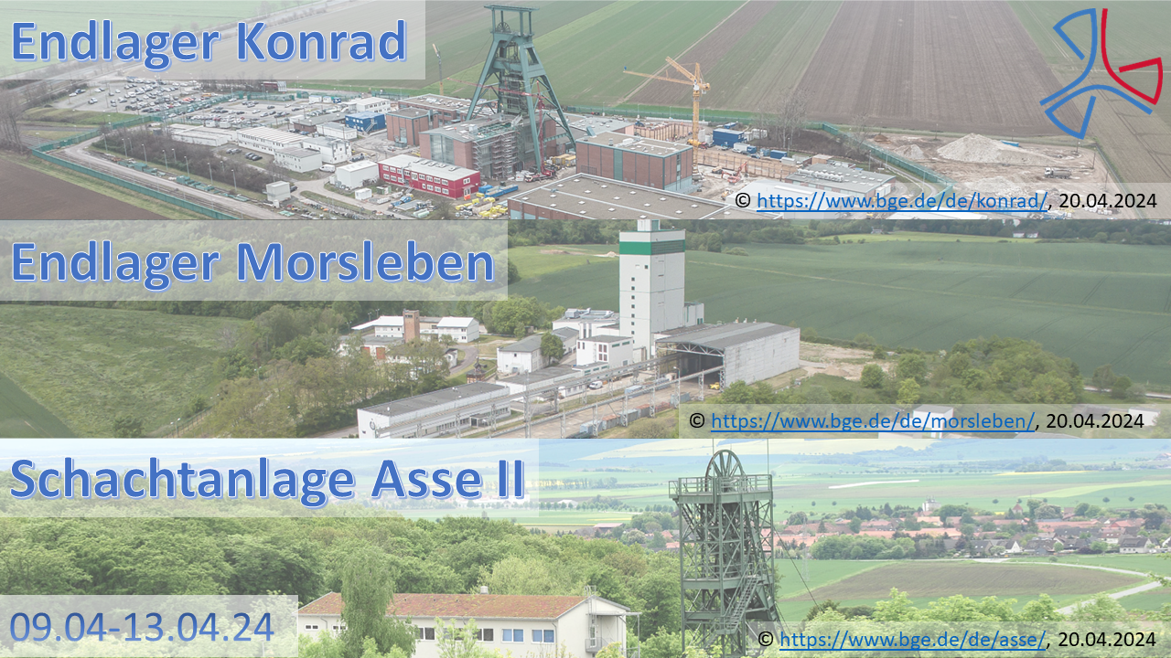
Excursions
Primary for Young Scientists & Professionals

Slide 8
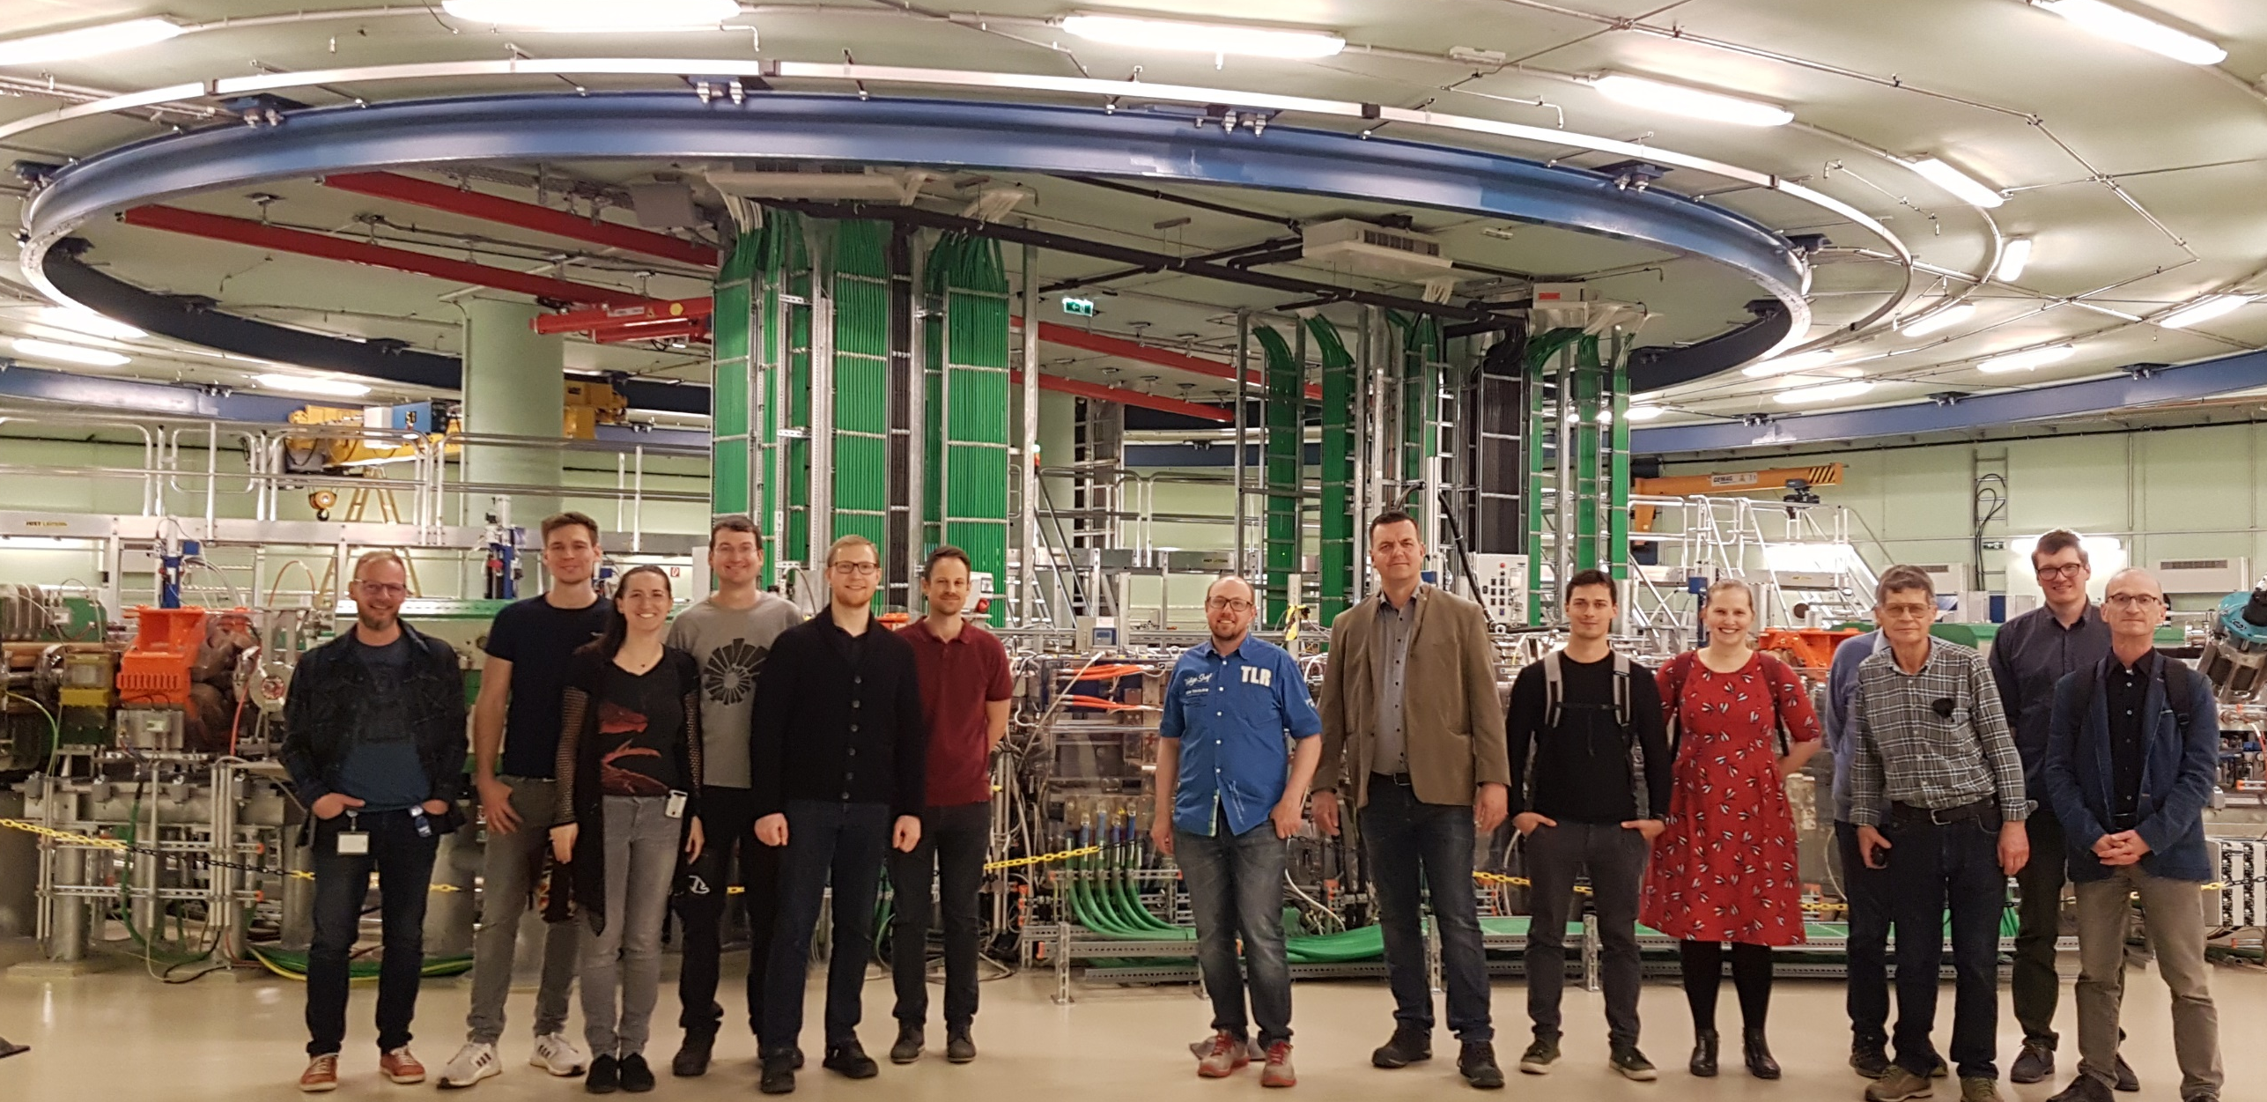
MedAustron
Wr. Neustadt

Slide 9
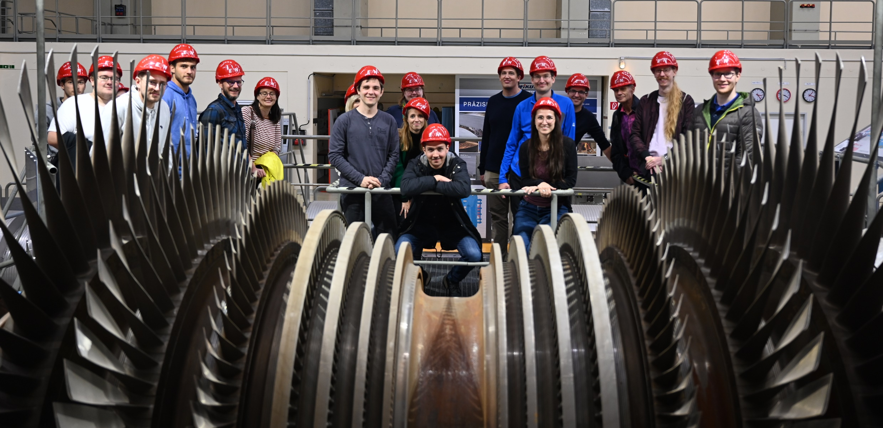
Power Plant Zwentendorf
Lower Austria

Slide 10
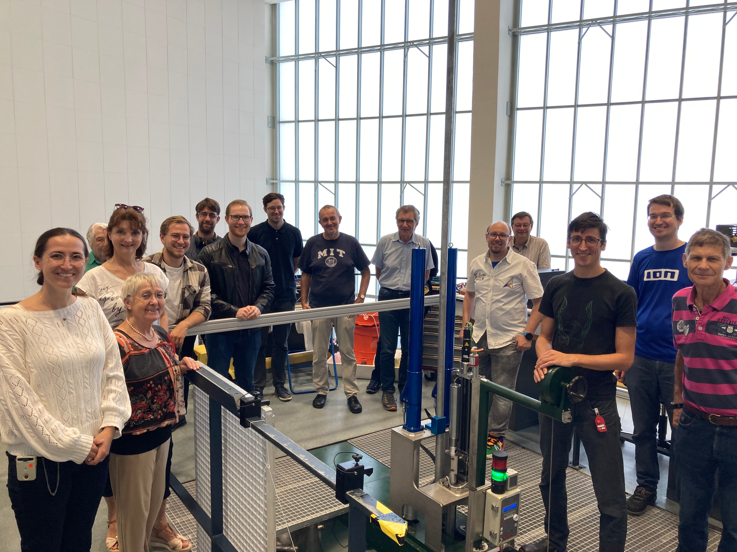
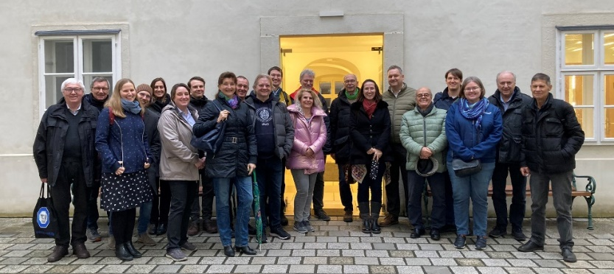
Excursions
Open for every member

Slide 11
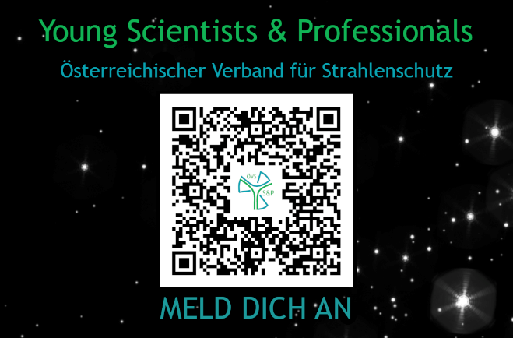
Business Cards
The best way to connect!

Slide 12
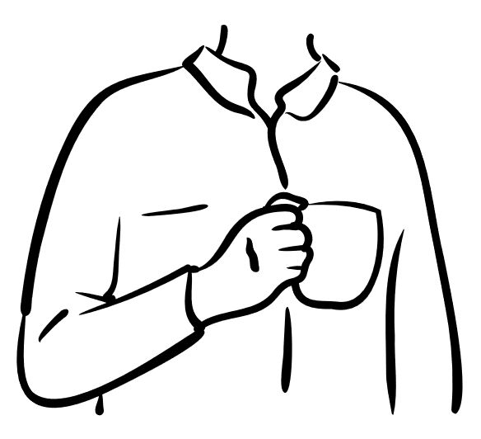
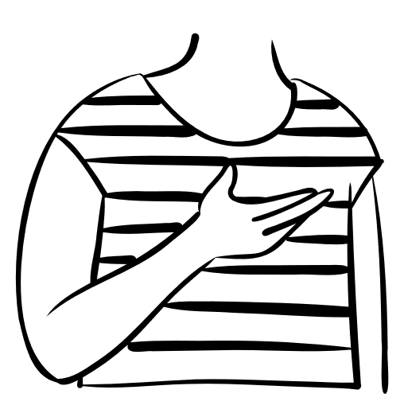
Flyer
Mentoring Program
To promote!
To support!

Slide 13
Do not hesitate!
Join us!
Notes:
https://strahlenschutzverband.at/

